Slide 1




Weekly report: Storage System
8th week – 9th Presentation
Date: 18 /11/2025
Supervisor: Dr. Laurence Alhrshy
Presented by :Mohamed Ahmed
18 /11/2025
Mohamed Ahmed
Storage System Team/ Optimus Syria

Slide 2
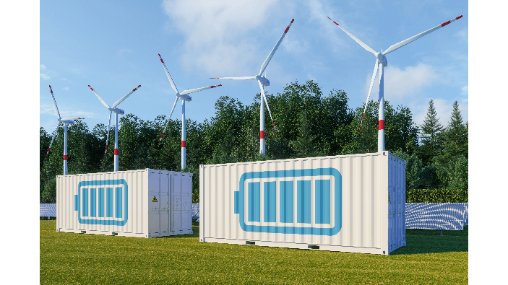
Content
Application Scenarios of Energy Storage
Society Benefits from Energy Storage
Needed parameters for the pre-processing
Energy Storage Simulation Workflow
References
avaada.com/advantages-of-wind-energy/
18/11/2025
2
Mohamed Ahmed
Storage System Team/ Optimus Syria

Slide 3
Application Scenarios of Energy Storage
Steadying Power Infeed.
Fast Frequency Response (FFR).
Synthetic / Continuous Inertia Provision.
Low Voltage Ride Through (LVRT).
Power System Stabilization (PSS).
Reduction of Mechanical Loads & Stress.
Support for Emergency Braking & Ramp Control.
18 /11/2025
Mohamed Ahmed
Storage System Team/ Optimus Syria

Slide 4
Society Benefits from Energy Storage
More stable and reliable electricity
Fewer blackouts and faster frequency recovery
Cheaper energy in the long term
More renewable energy penetration
Longer turbine lifetime and fewer maintenance shutdowns
18 /11/2025
Mohamed Ahmed
Storage System Team/ Optimus Syria

Slide 5
Needed parameters for the pre-processing
Aerodynamics:
  Air density
  Blade radius
  Rotor swept area
  Cp
  thrust coefficients
Drive Train:
  Rotor inertia
  Generator inertia
  Gearbox ratio
Generator:
  Generator efficiency
  Torque constant
Tower Dynamics:
  Tower mass
  Stiffness
  Tower height
Pitch Actuator:
  Pitch angle limits
  Time constant
Battery Storage:
  Battery capacity
  Nominal voltage
  Maximum charge/discharge rate
  Initial SOC
  Rotor Hub
  Nacelle inertia about yaw axis
  Generator
18/11/2025
Mohamed Ahmed
Storage System Team/ Optimus Syria

Slide 6
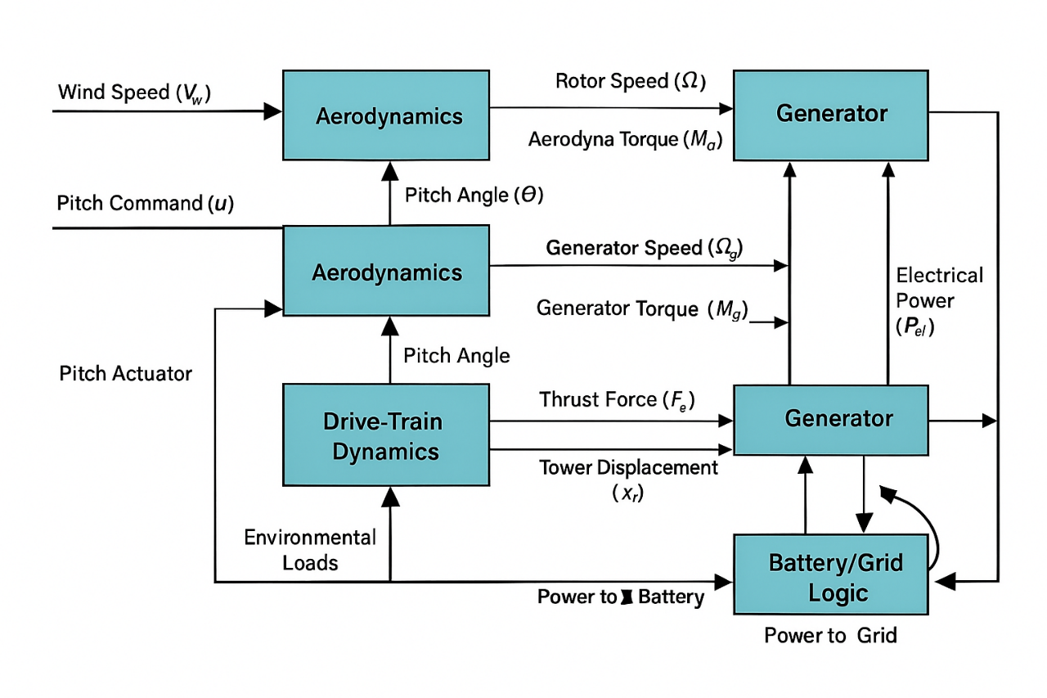
Energy Storage Simulation Workflow
  Wind speed enters the Aerodynamics block → calculates λ, Ma, and Fa.
  Drive Train uses Ma → produces rotor speed (Ω) and generator speed (Ωg).
  Generator converts Ωg into electrical power (Pel) and generator torque (Mg).
  Pitch Actuator adjusts blade angle (θ) based on the control input (u).
  Tower Dynamics use Fa → give tower displacement (xT).
  Battery/Grid Logic takes Pel + SOC → sends power to grid or battery.
  Feedback Control maintains stable speed, torque, and power.
Source: Own creation
  Simulation Outputs
  Battery State of Charge (SOC)
  Battery/Grid Switching Signal
18/11/2025
Mohamed Ahmed
Storage System Team/ Optimus Syria

Slide 7
Next Presentation
Cable Calculations
Converter Calculations
18 /11/2025
7
Mohamed Ahmed
Storage System Team/ Optimus Syria

Slide 8
References
https://www.osti.gov/biblio/1847886
https://www.nrel.gov/docs/fy21osti/78347.pdf
Grid Services and Stress Reduction with a Flywheel in the Rotor of a Wind Turbine Clemens Jauch
18 /11/2025
Mohamed Ahmed
Storage System Team/ Optimus Syria
Notes:
Future works ??

